Slide 1


Slide 2
Bloomberg for Futures
Explore Futures, Futures Conventions
Futures in Comdty, Futures in Energy
CL – DES, CT (Term Structure, Spreads, Flies)
FLDS, API
Setttings and appropriate data for trading.
Data downloading methods, Excel and Python
Excel and Python examples on Github

Slide 3
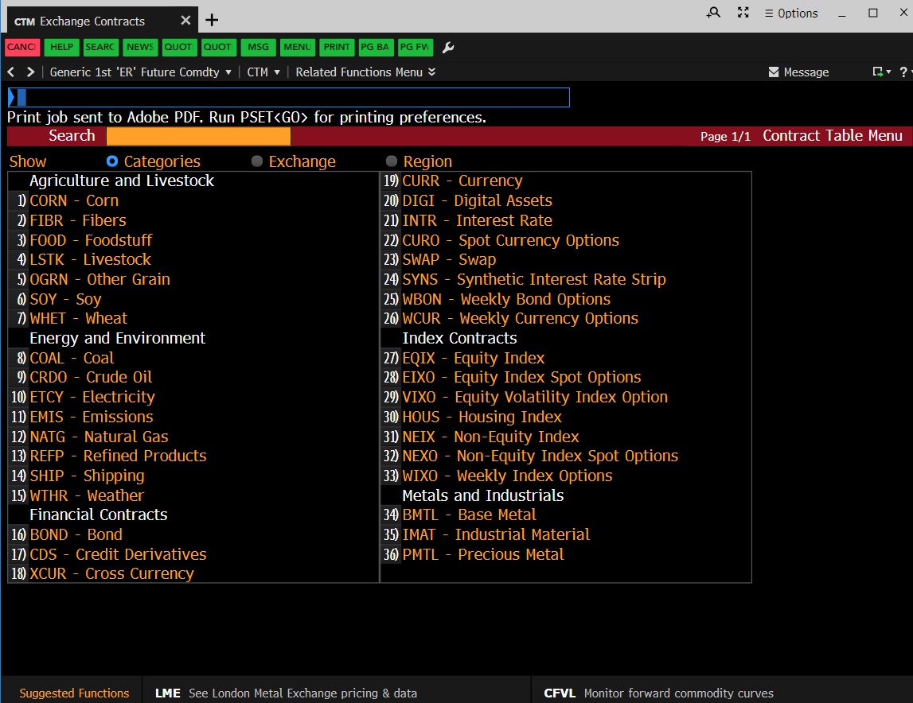
Futures Data

Slide 4
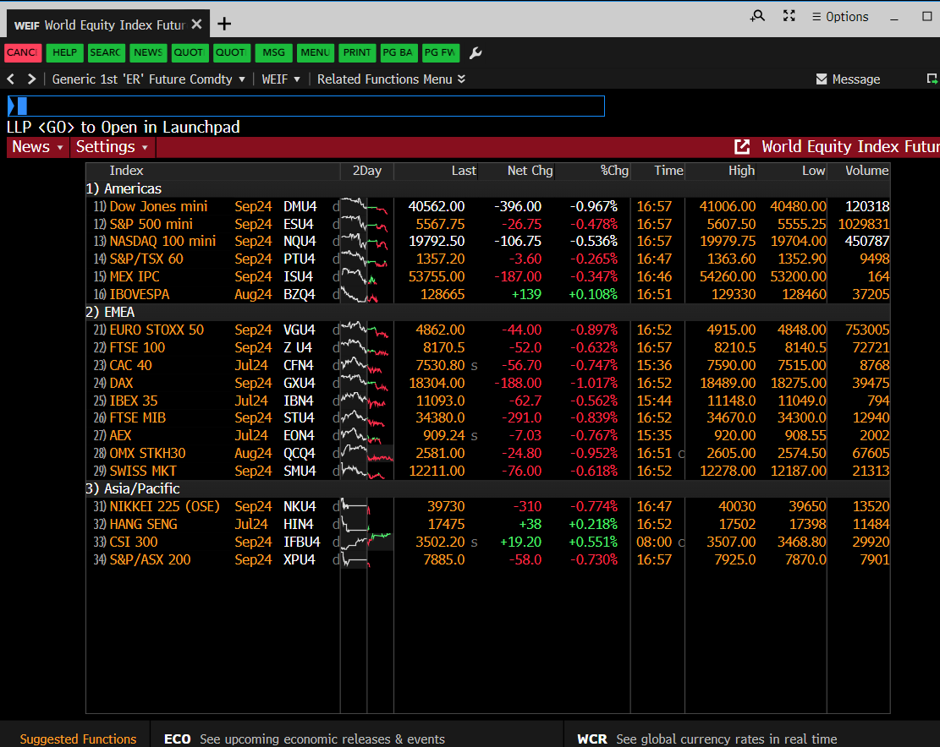
Index Futures

Slide 5
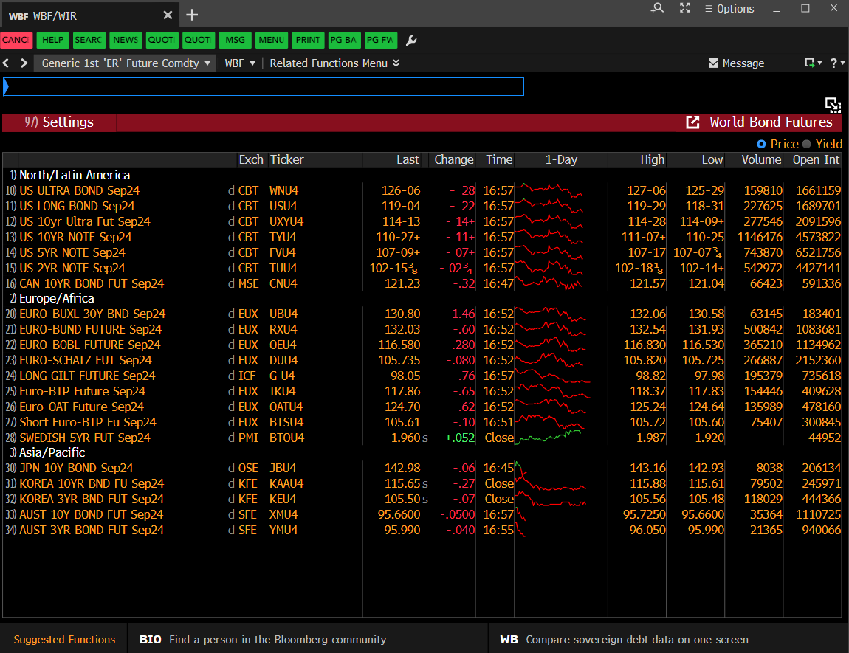
Bond Futures

Slide 6
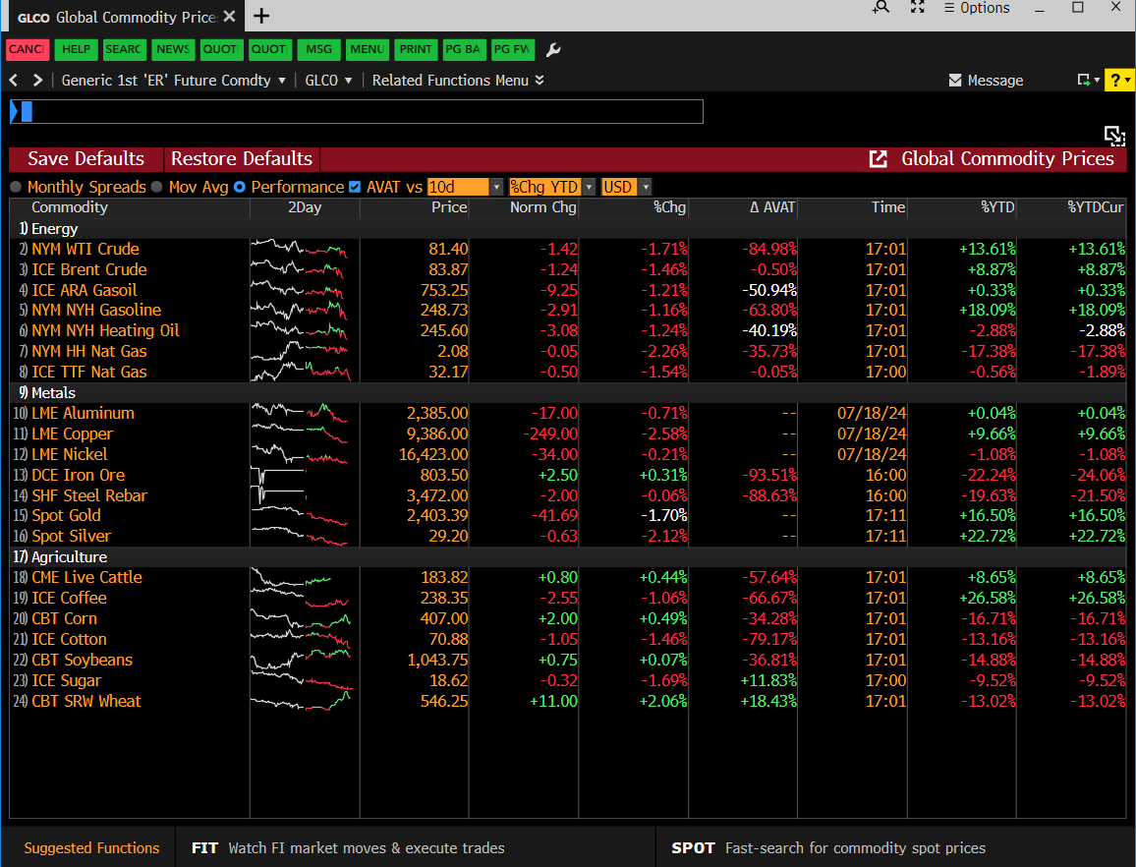
Commodity Futures
* All Commodity types:
Metals (Precious+Industrials)
Ags (Softs, Cereals, etc), Livestocks
Energy + Weather etc
In one place

Slide 7
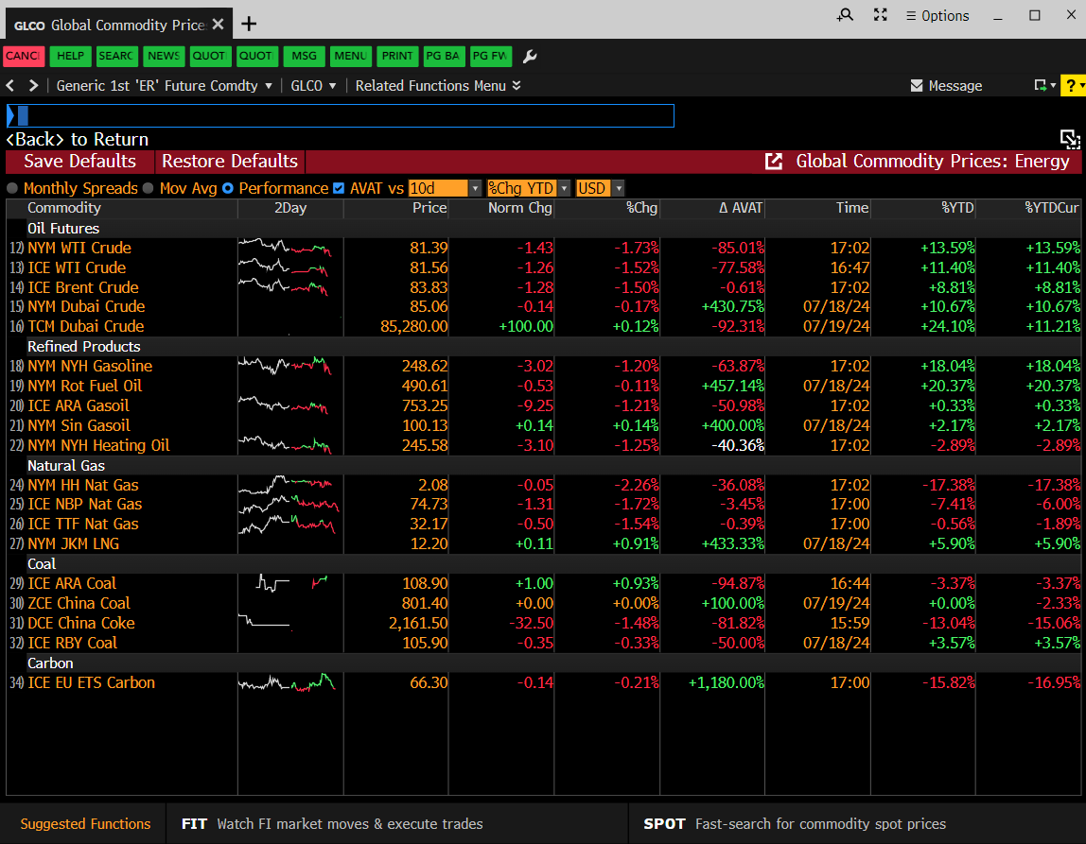
Energy Futures

Slide 8
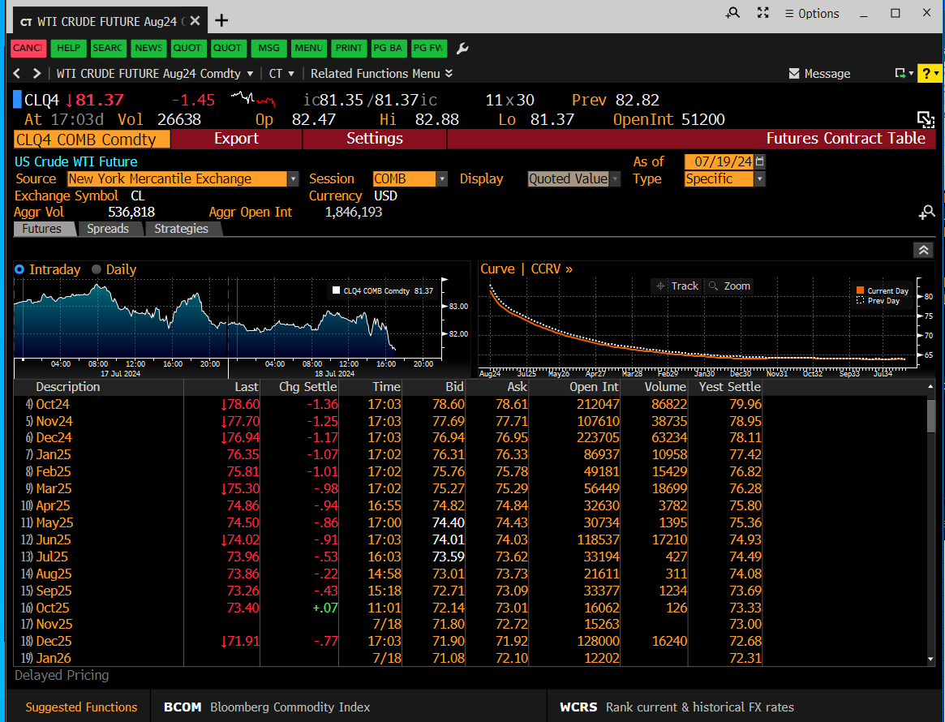
CLA – Contract Table

Slide 9
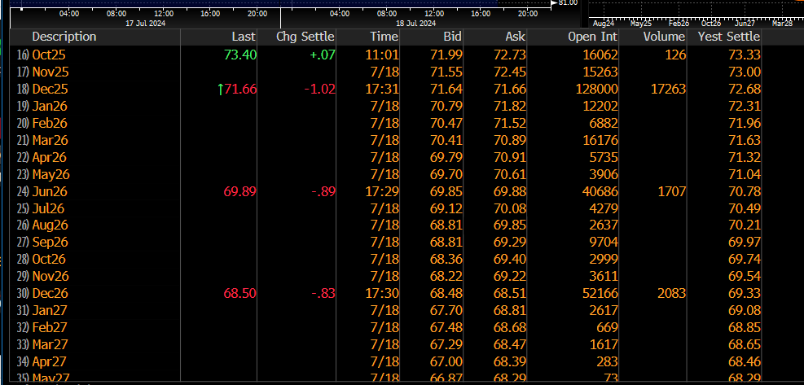
CLA – Contract Table (cont’d)

Slide 10
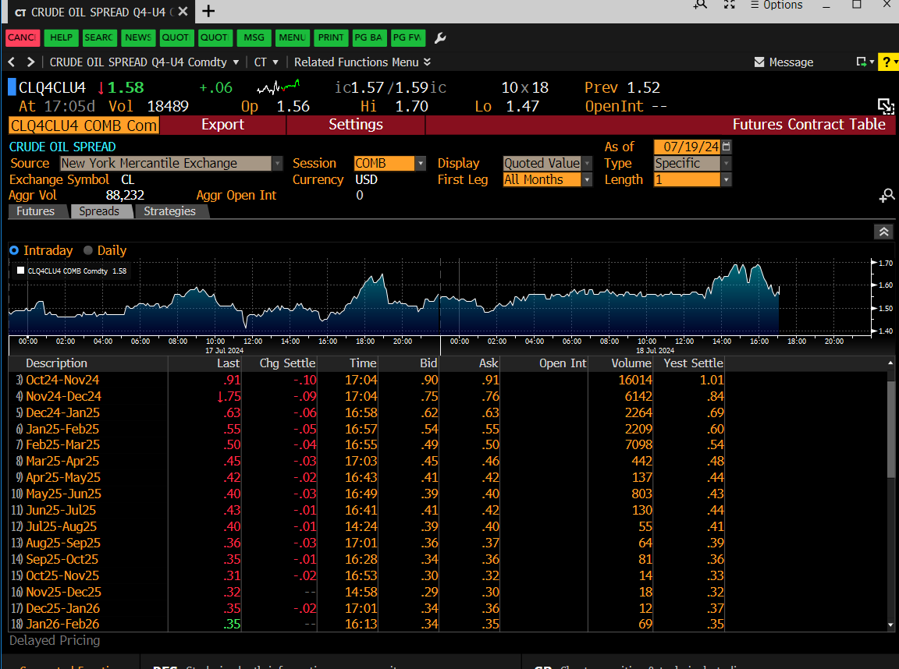
CLA – Spreads

Slide 11
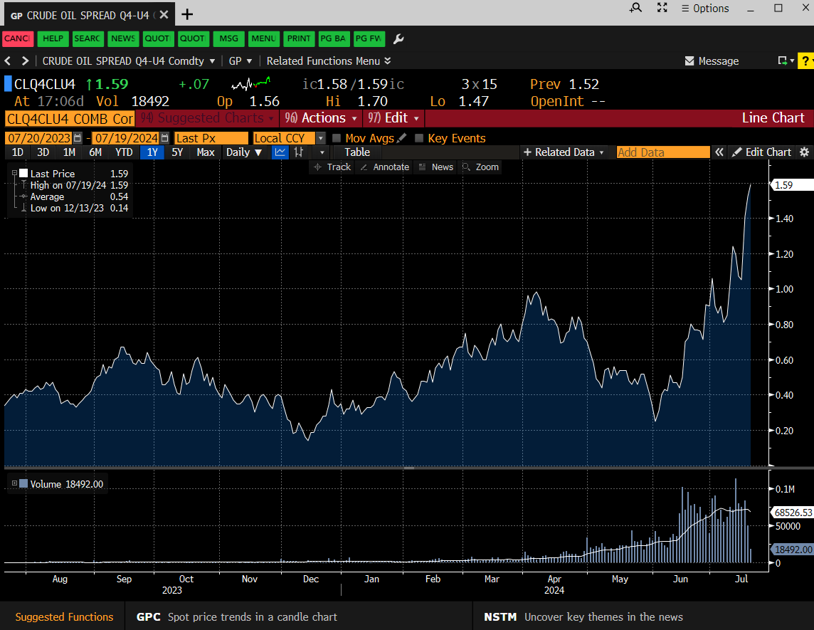
CLA – Spread liquidity closer to roll

Slide 12
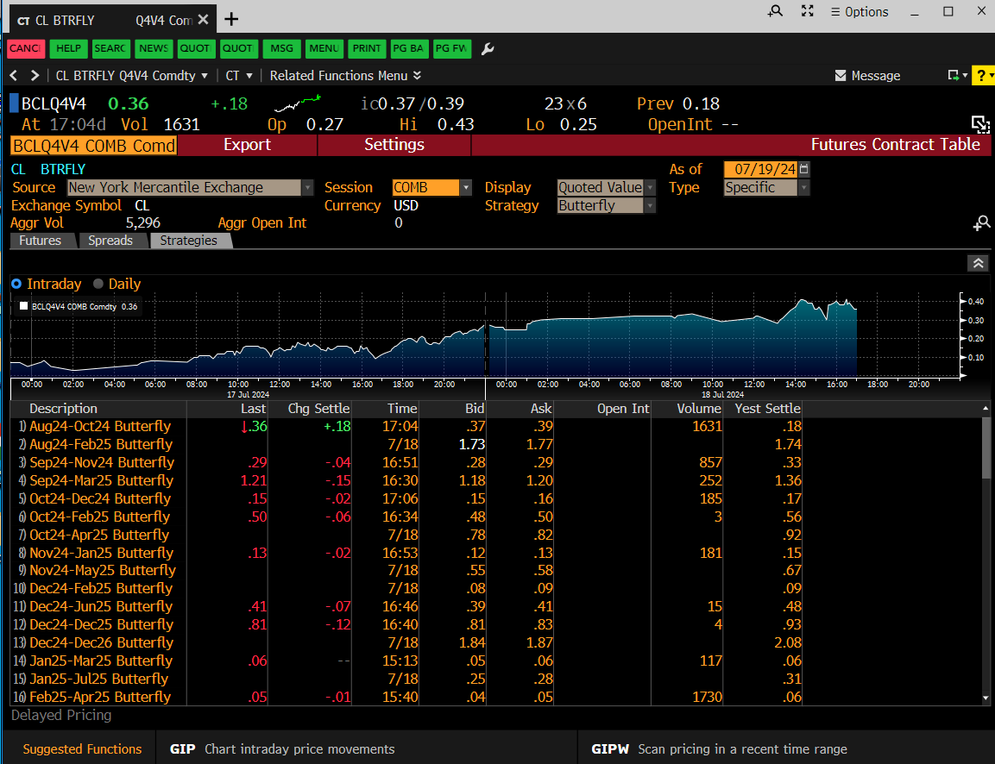
CLA – Flies

Slide 13
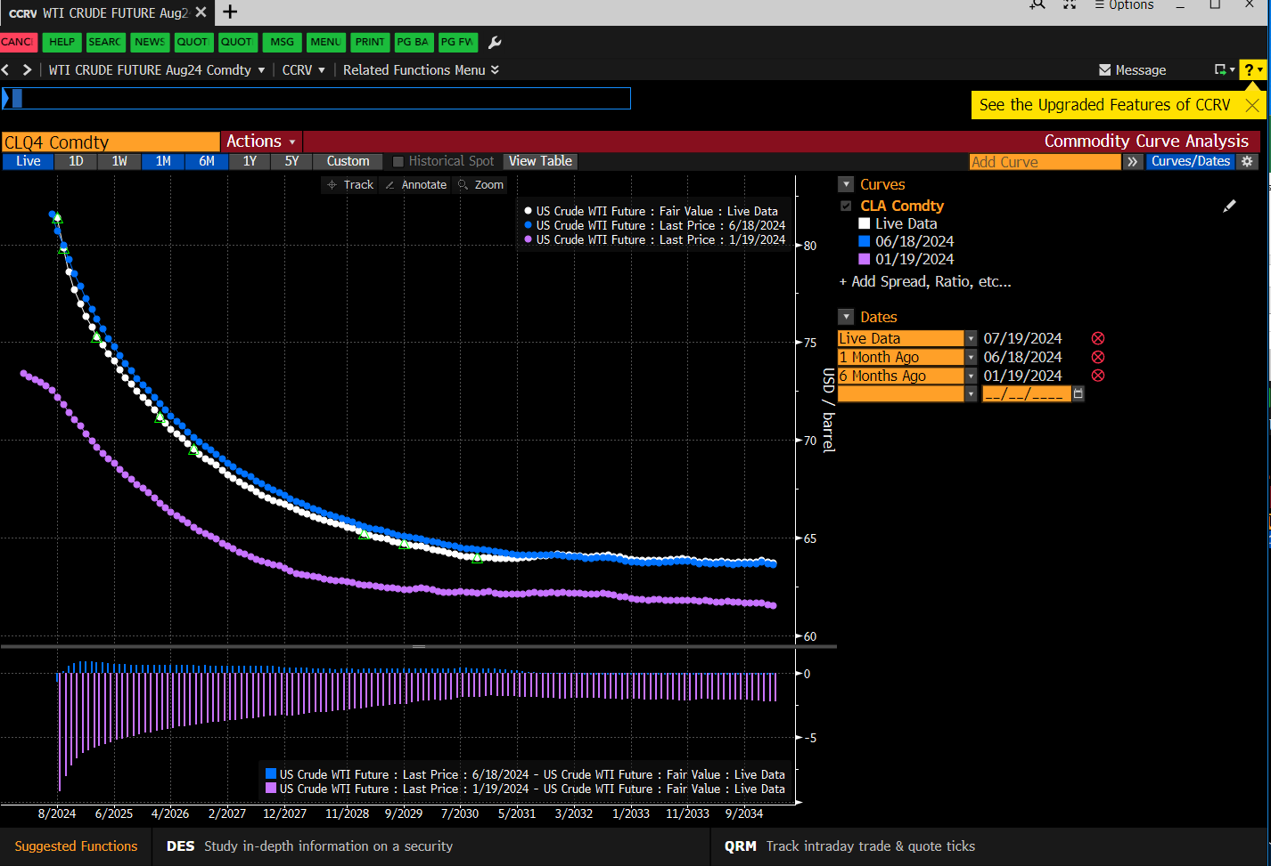
CL – The Curve Evolution

Slide 14
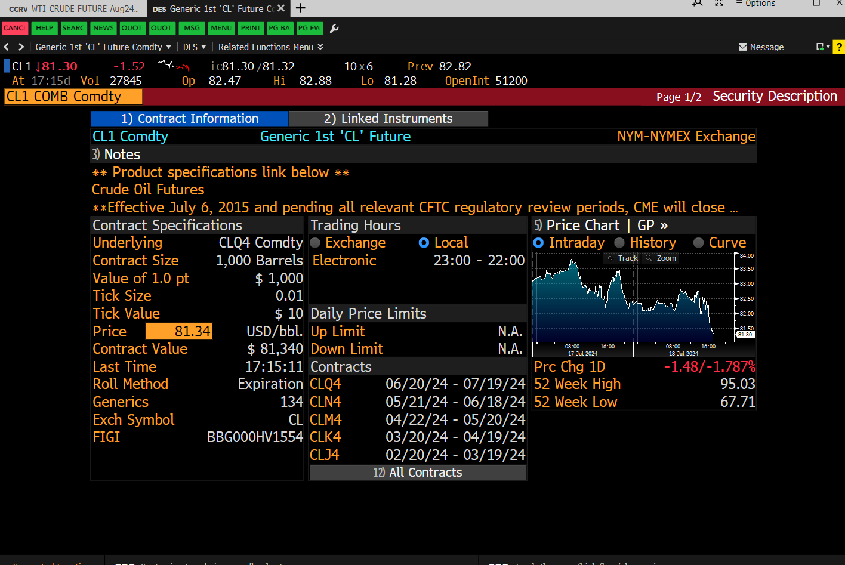
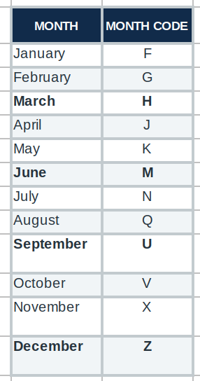
CL1 – DES - CLQ4 (Aug-24)

Slide 15
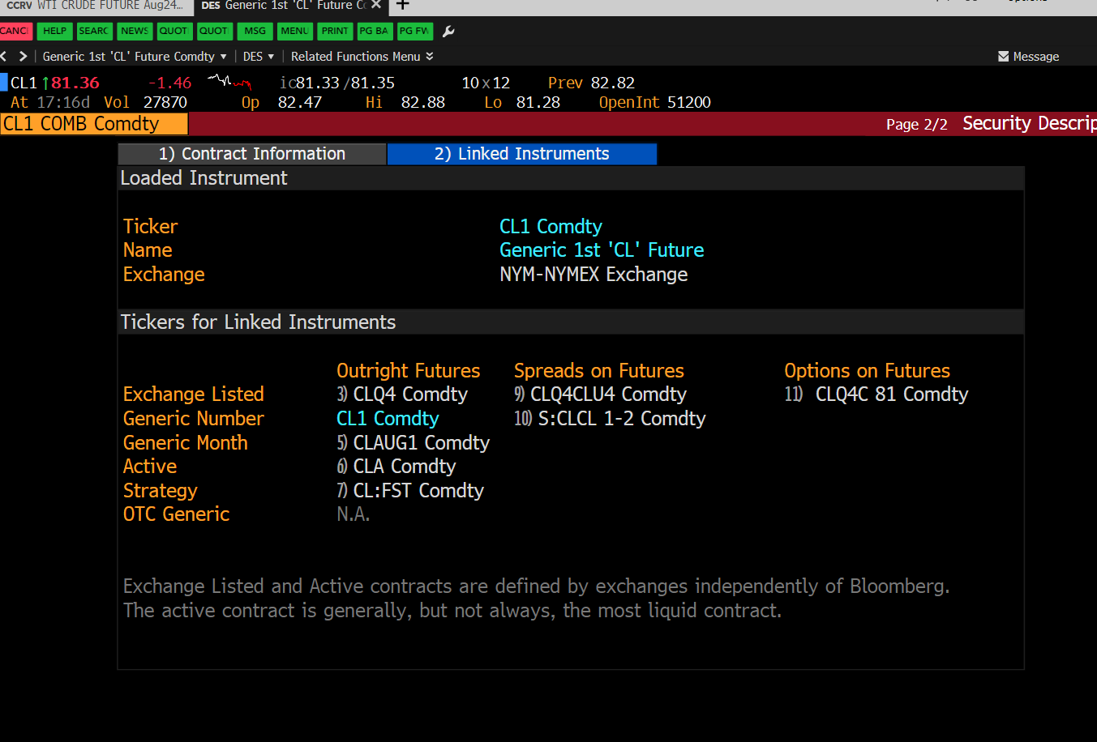
CL1 – DES - CLQ4 (Aug-24)

Slide 16
CL Futures
Curve Trades for >10y.
Monthly contracts (serials). Roll Monthly.
Significant Liquidity only in 0-1/2 years and Dec contracts (i.e., only feasible for more frequent trading)
Can execute longer futures for infrequently traded strategies.
Spreads not particularly liquid, but most effective for roll

Slide 17
Downloading data
FLDS. Available in Terminal, in excel and in API are entirely different.
Bloomberg defaults – nobody ever wanted them. #N/A N/A??
Always #N/A. You can choose how to fill.
5BD. Need to find holidays manually
Let BBG find rolled prices, you roll contracts
Find Contract name, Find relevant dates.
Various Roll methods – proportional or difference. You choose.

Slide 18
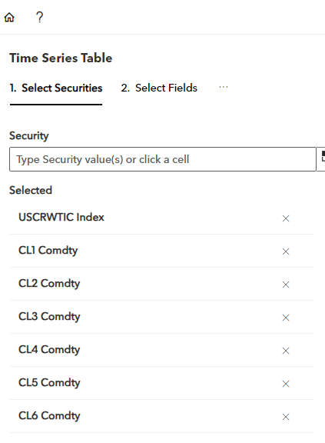
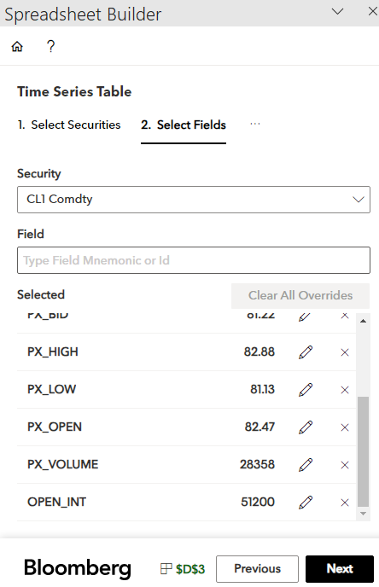
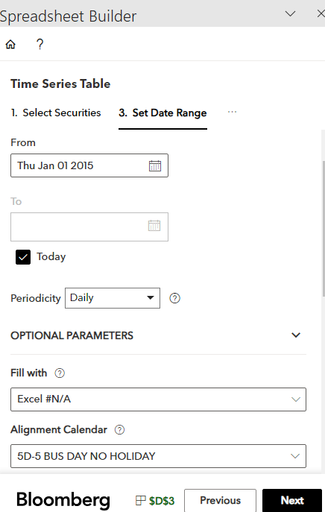
Downloading data
Choose BBG generics and “spot”
Bars and Cur_Generic contract

